Slide 1
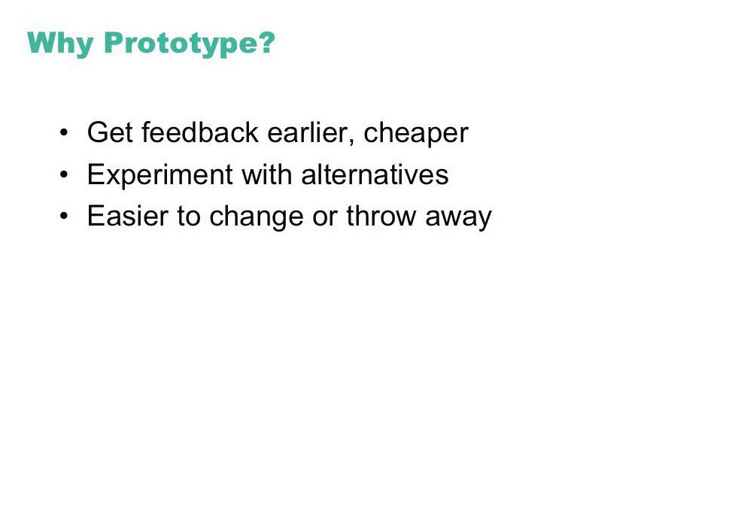

Slide 2
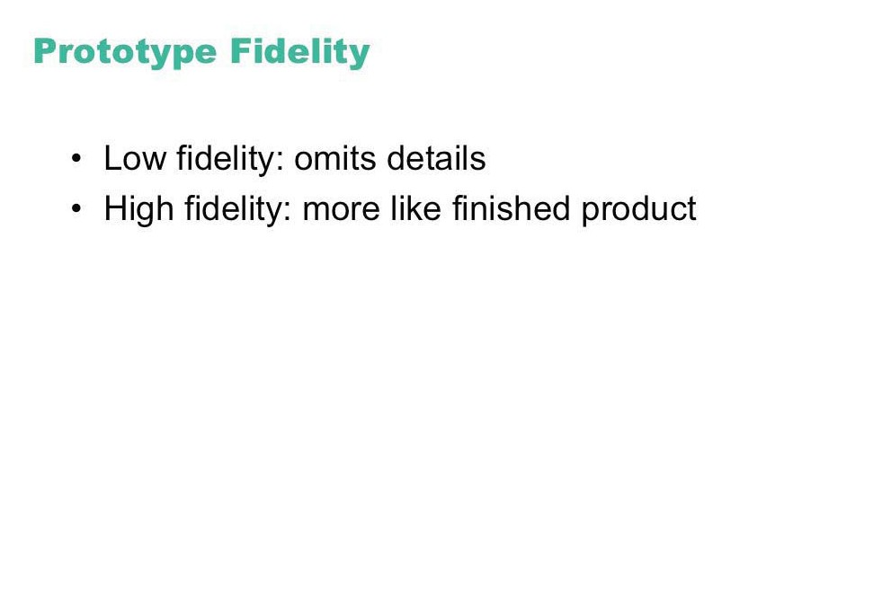

Slide 3
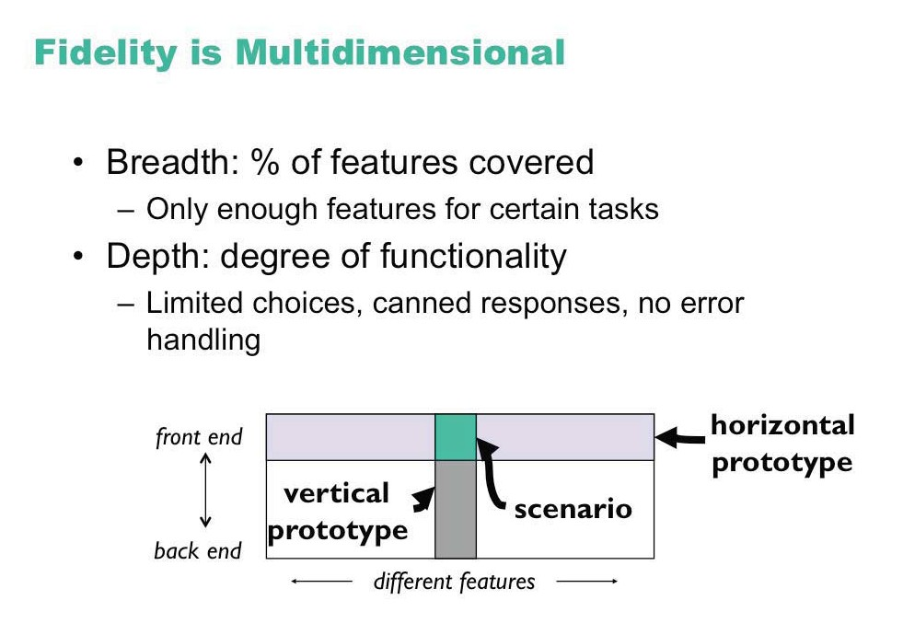

Slide 4
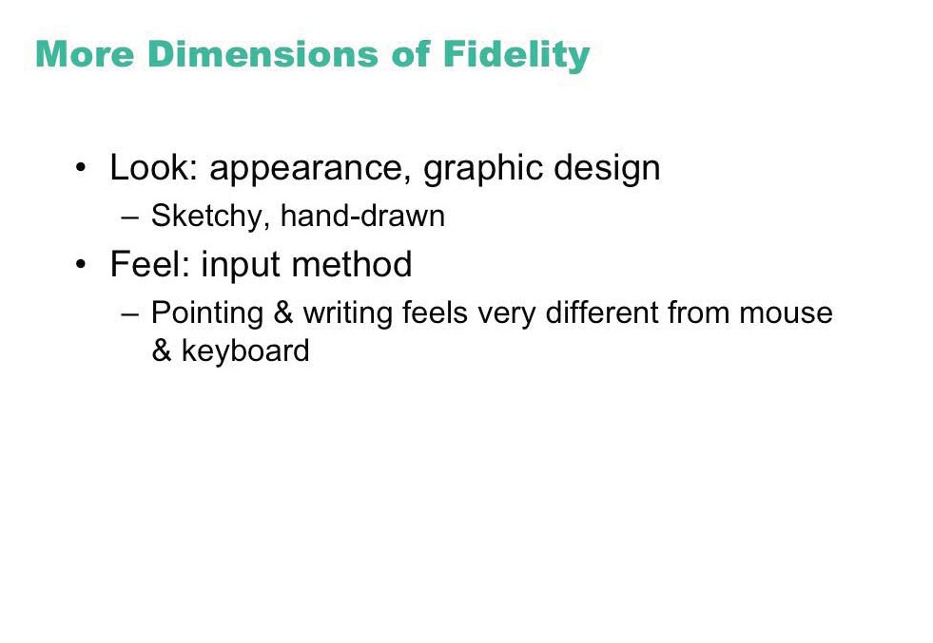

Slide 5
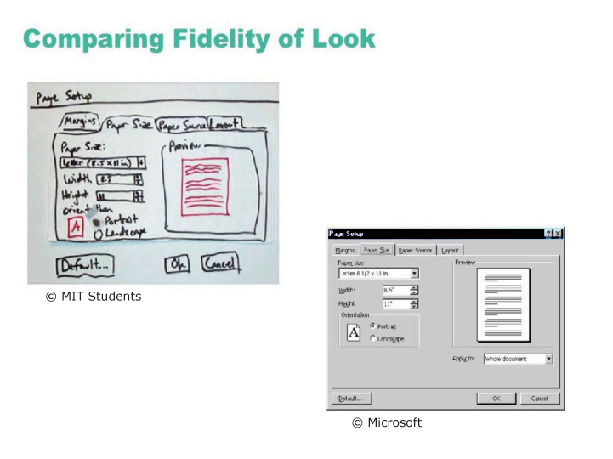
© MIT Students
© Microsoft

Slide 6
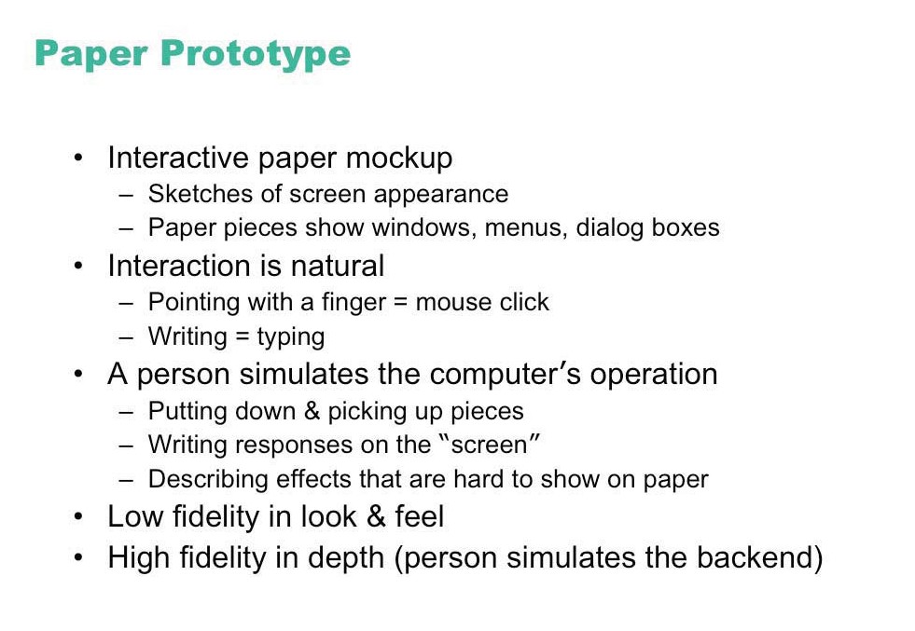

Slide 7
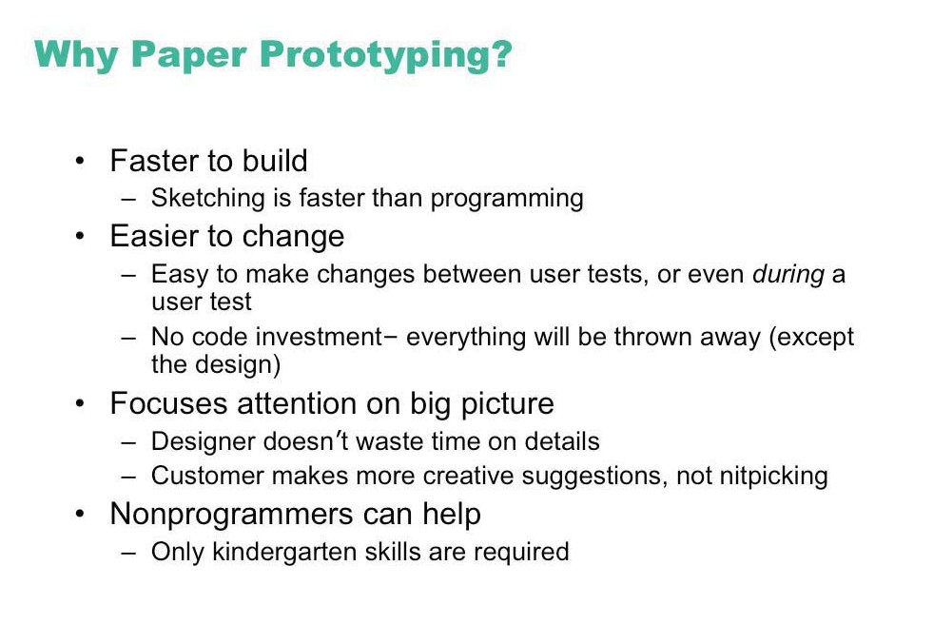

Slide 8
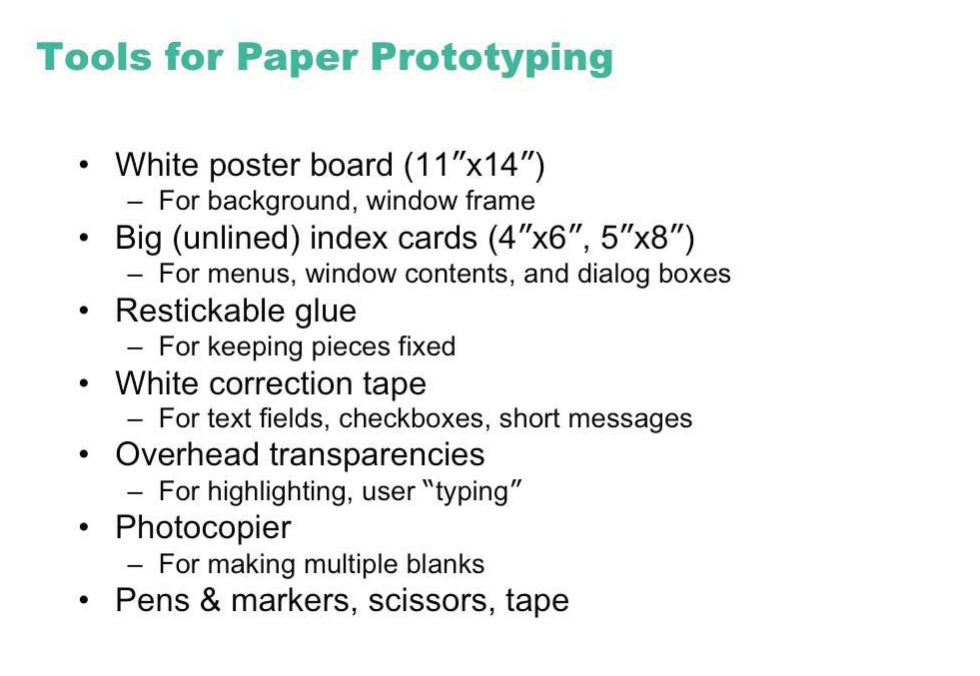

Slide 9
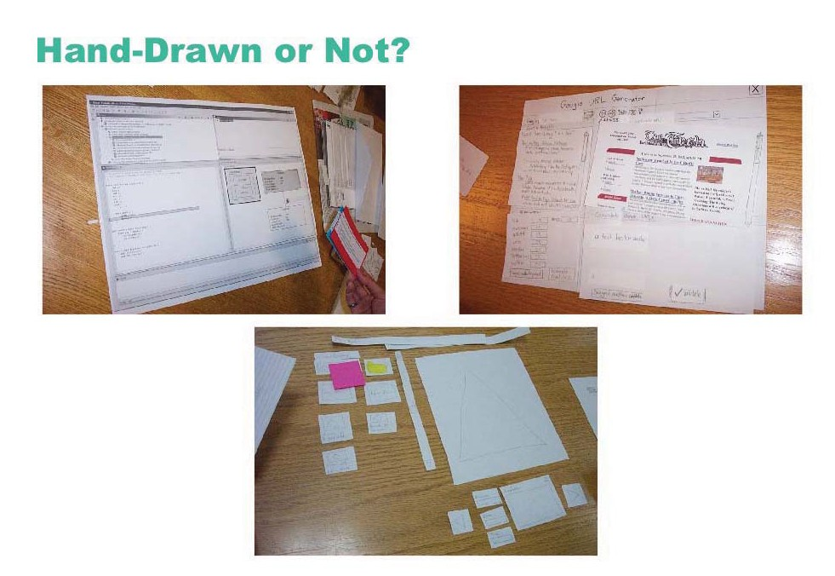

Slide 10
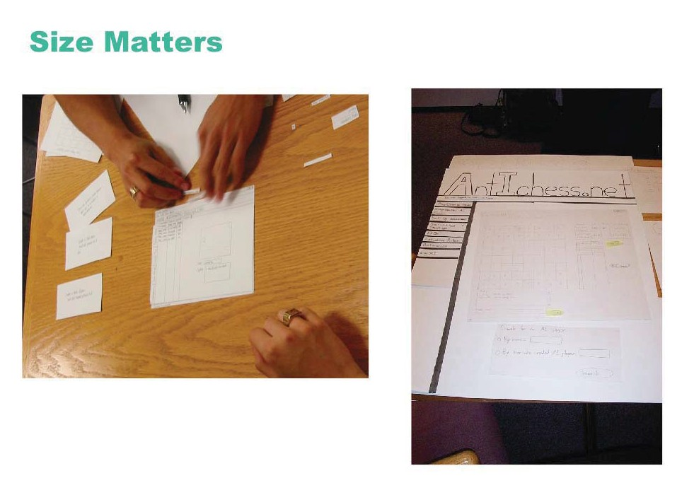

Slide 11
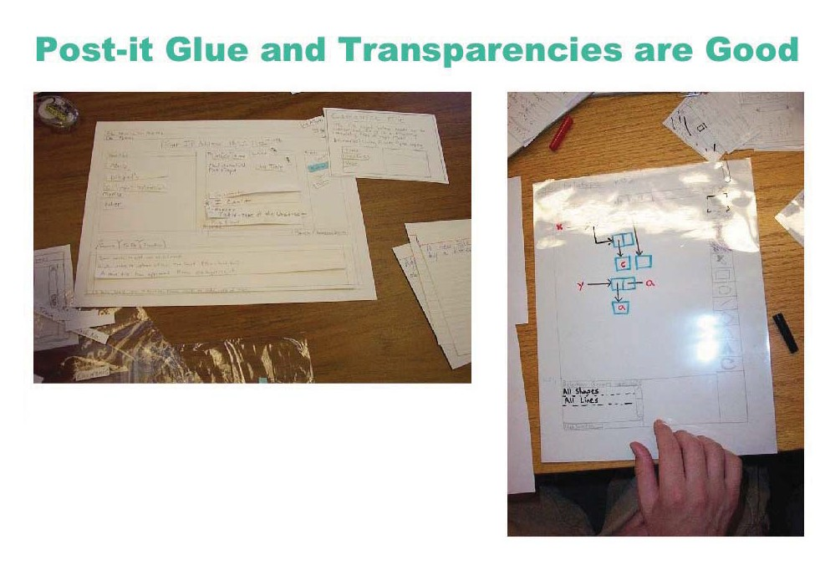
© MIT Students

Slide 12
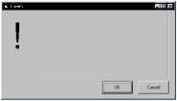

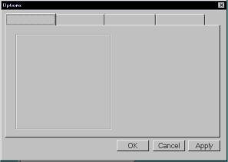
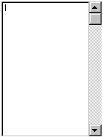

PICTIVE (Plastic Interface for Collaborative Technology Initiatives through Video Exploration)
Use pre-made paper interface components
buttons
menu
alert box
combo box
tabs
list box
entries

Slide 13
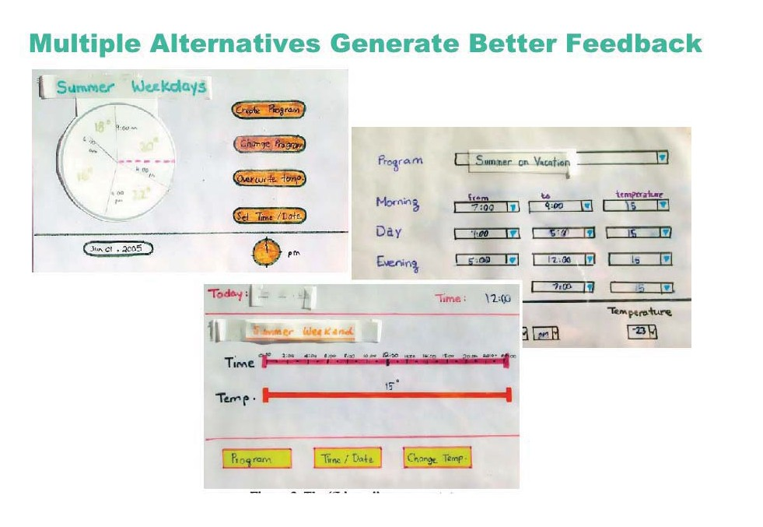
© Association for Computing Machinery

Slide 14
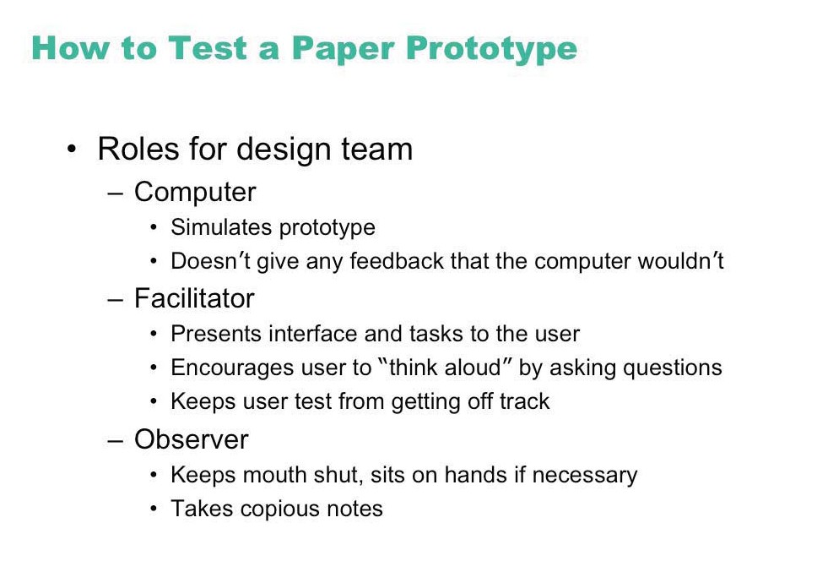

Slide 15
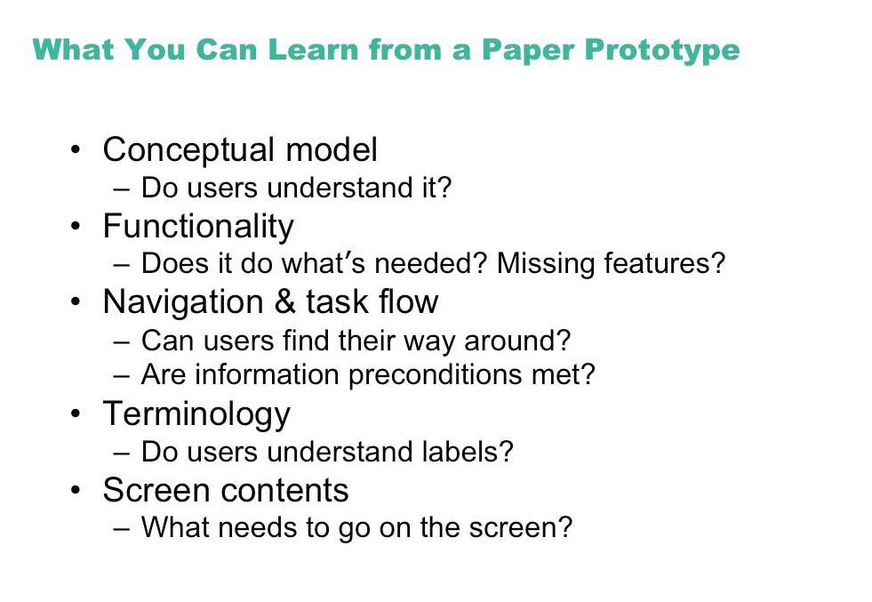

Slide 16
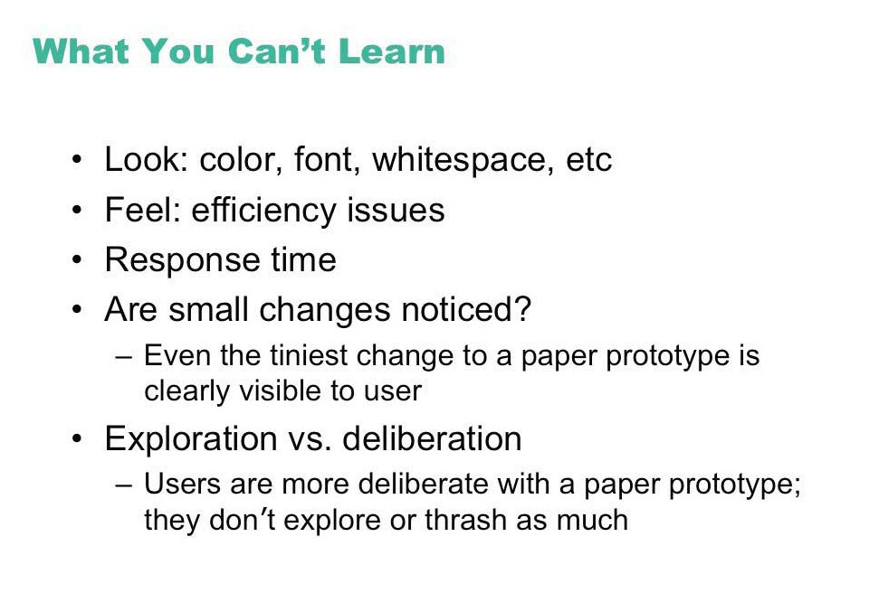

Slide 17
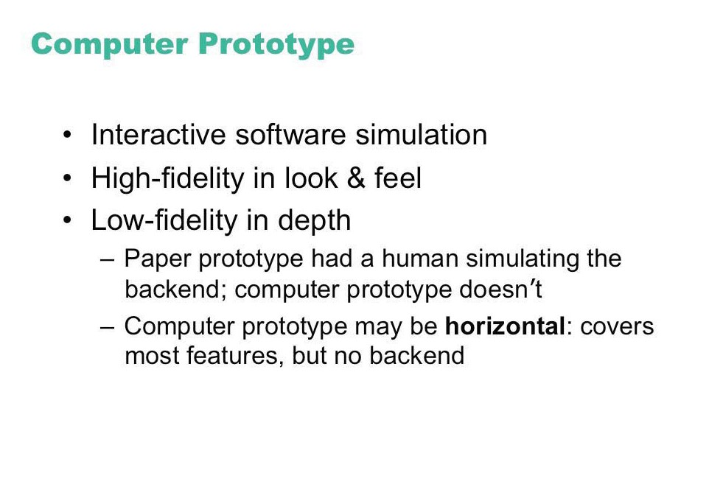

Slide 18
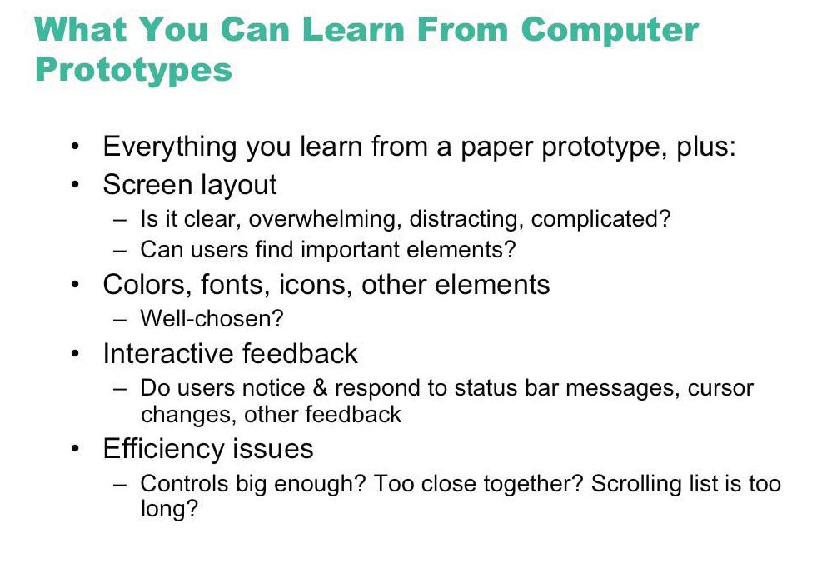

Slide 19
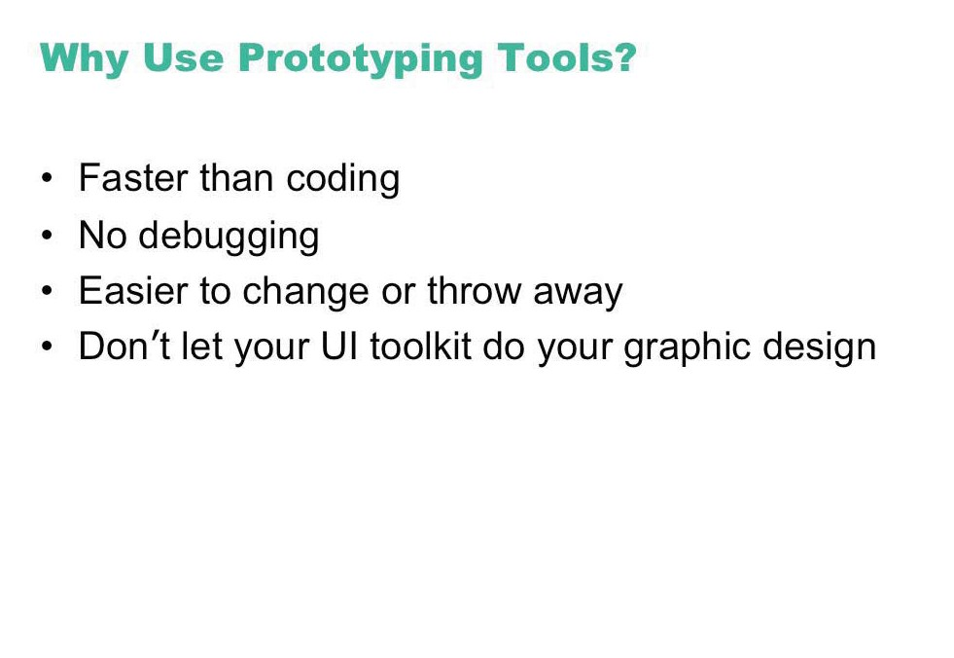

Slide 20
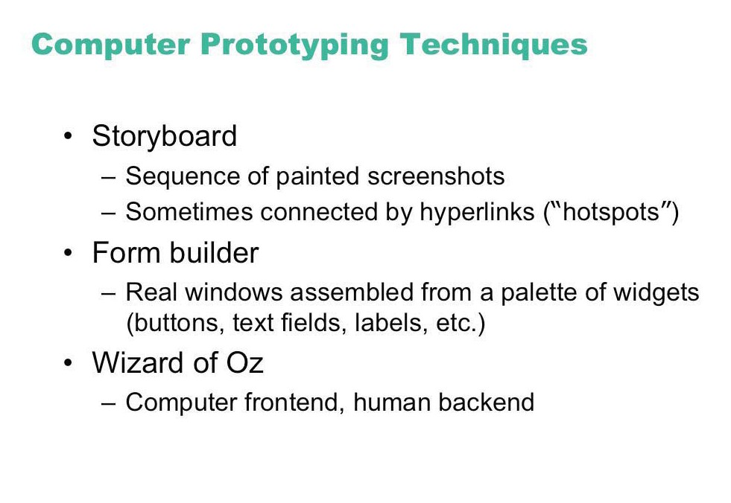

Slide 21
Painting/drawing programs
draw each storyboard scene on computer
very thin horizontal prototype
does not capture the interaction “feel”

Slide 22
Scripted simulations
create storyboard with media tools
scene transition activated by simple user inputs
a simple vertical prototype
user given a very tight script/task to follow
appears to behave as a real system
script deviations blow the simulation
Control panel for pump 2
Control panel for pump 2
DANGER!
coolant flow 45 %
coolant flow 0 %
retardant 20%
retardant 20%
speed 100%
speed 100%
Shut Down
Shut Down

Slide 23
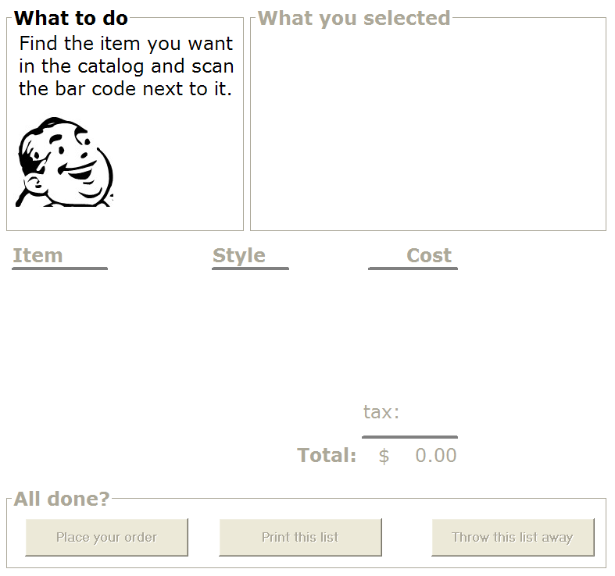
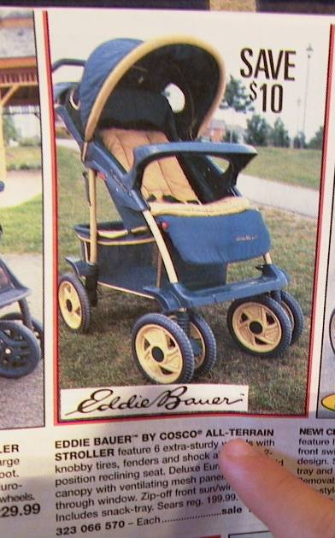

Slide 24
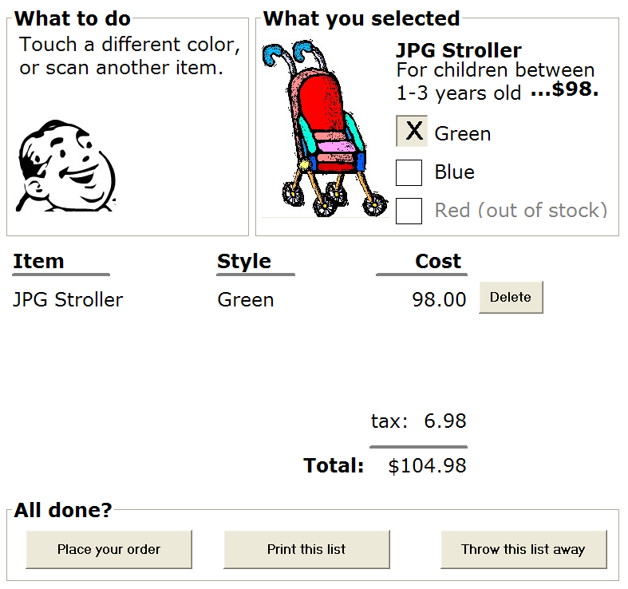

Slide 25


Slide 26


Slide 27
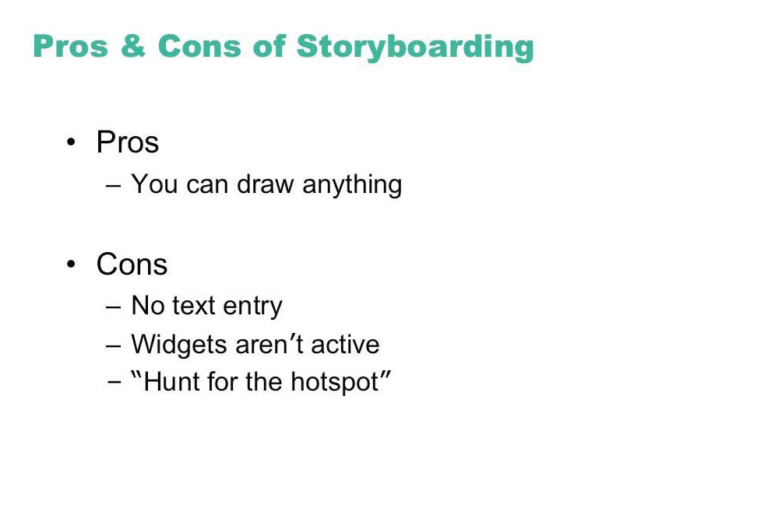

Slide 28
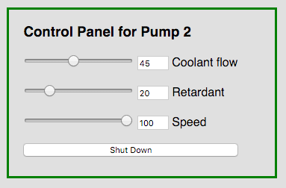
GUI Toolkits and Interface Builders
Design tools for laying out common widgets
excellent for showing look and feel
a broader horizontal prototype
but constrained to widget library
vertical functionality added selectively
through programming

Slide 29
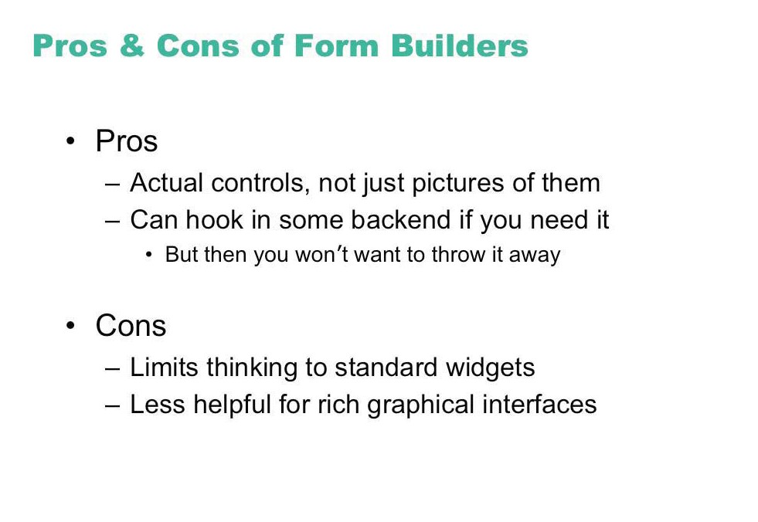

Slide 30
Videos
Early research on prototyping tools
James Landay
http://www.youtube.com/watch?v=VLQcW6SpJ88
Scott Klemmer
http://www.youtube.com/watch?v=IbRFK0lHFpc

Slide 31
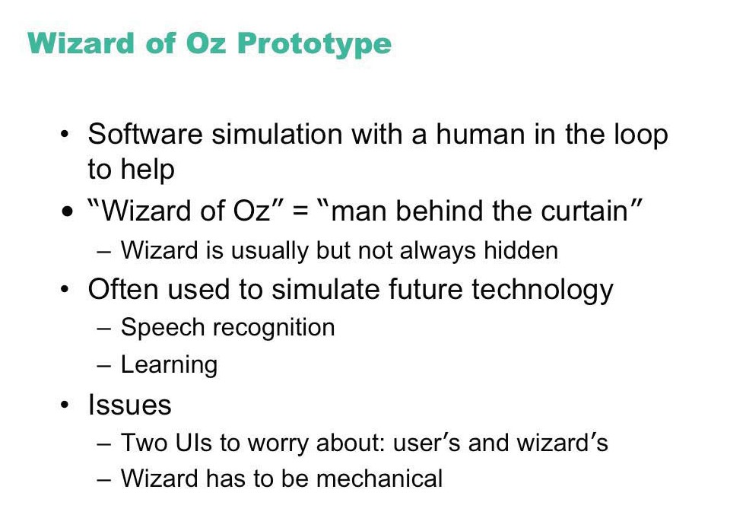

Slide 32
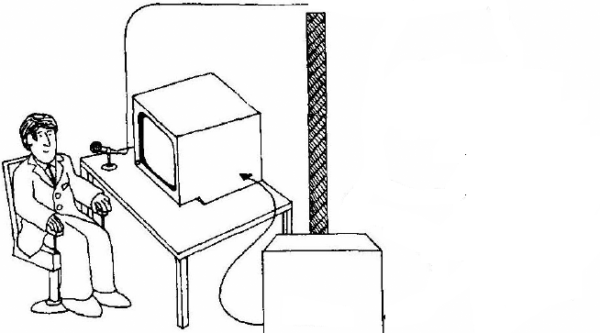
Wizard of Oz
A method of testing a system that does not exist
the listening typewriter, IBM 1984
Dear Henry
Speech Computer
What the user sees
From Gould, Conti & Hovanvecz, Comm ACM 26(4) 1983.

Slide 33
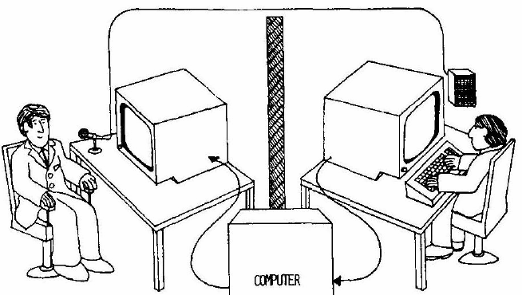
Wizard of Oz
A method of testing a system that does not exist
the listening typewriter, IBM 1984
Dear Henry
Dear Henry
Speech Computer
What the user sees
The wizard
From Gould, Conti & Hovanvecz, Comm ACM 26(4) 1983.

Slide 34
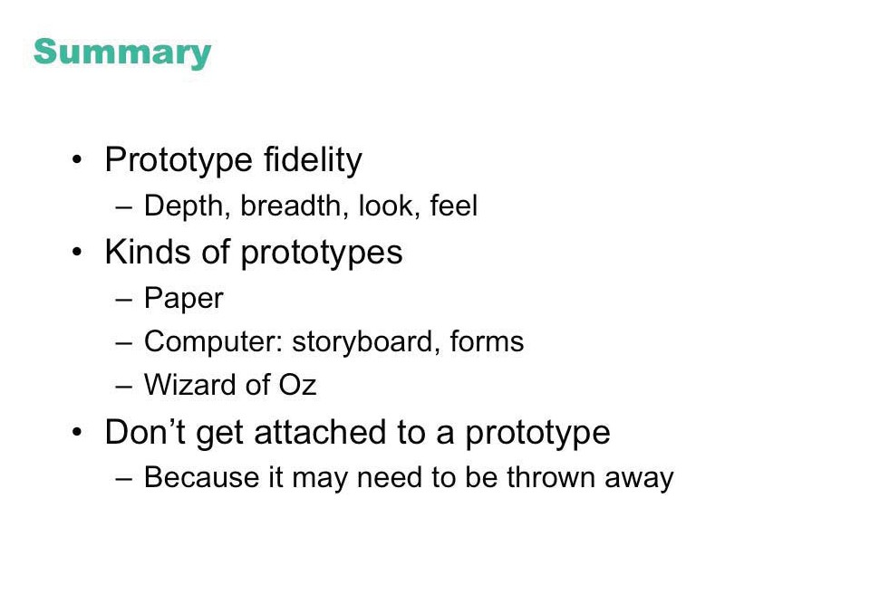

Slide 35
Computer Prototyping Tools
HTML (more...)
Write simple HTML in desktop or mobile browser
Can add Javascript
Powerpoint (or Keynote or Libre Office or Google Slides) (more...)
Canned slide show
Random-access slide show, using hyperlinks
Drawing program + storyboard or hyperlink feature
Vector drawing : Sketch, Adobe XD, Inkscape
Raster drawing: Photoshop, Gimp, (Mac Preview)
Powerpoint, Word
Scan your sketches, then transition among them with mouse clicks
For WWW links, see Canvas page “Prototyping resources"

Slide 36
Computer Prototyping Tools (contd)
Visual Basic (more...)
Axure
Balsamiq
Sketch
Xojo (Visual Basic lookalike)
CogTool
XCode's storyboard feature (more...)
For WWW links, see Canvas page “Prototyping resources"

Slide 37
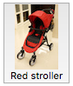
Using Simple HTML for Prototyping
Make a regular HTML page that looks like what you want, with text, images, or anything else.
Make some more pages, similar to the first, for the possible actions in your prototype. Put each into a separate HTML file.
Put links from the text, buttons, or images on each page to the appropriate HTML file for that action. For example:
A regular text link:
<a href="page2.html">Red stroller</a>
A button with text inside:
<button type="button" onclick="location.href='page2.html'" >Red stroller</button>
A button with text and an image inside:
<button type="button" onclick="location.href='page2.html'">
<img src="redstroller.jpg" />
<br/>
Red stroller
</button>
Notes:
Images = tiny screendumps from courses/171/code/htmlprototyping.slide.html

Slide 38
Simple HTML
html>
<head>
<title>Javascript example SimpleButton1</title>
</head>
<body>
<p>
<a href="SimpleButton1a.html"> [Push me]</a>
<p>
<a href="SimpleButton1b.html"> [Push me also]</a>
<p>
<b>Status:</b> (Nothing pushed)</p>
</body>
</html>
html>
<head>
<title>Javascript example SimpleButton1</title>
</head>
<body>
<p>
<a href="SimpleButton1a.html"> [Push me]</a>
<p>
<a href="SimpleButton1b.html"> [Push me also]</a>
<p>
<b>Status:</b> Button labeled 'Push me' was pushed</p>
</body>
</html>
html>
<head>
<title>Javascript example SimpleButton1</title>
</head>
<body>
<p>
<a href="SimpleButton1a.html"> [Push me]</a>
<p>
<a href="SimpleButton1b.html"> [Push me also]</a>
<p>
<b>Status:</b> Button labeled 'Push me also' was pushed</p>
</body>
</html>
Notes:
Source: courses/171/slides/show/04c.SimpleButton1.html, 04cc.SimpleButton1a.html, 04cc.SimpleButton1b.html

Slide 39
HTML + Javascript
<html>
<head>
<title>Javascript example SimpleButton2</title>
<script type="text/javascript">
function buttonPressed (str) {
// Reach into HTML and change it
document.getElementById("statusmsg").innerHTML = "Button labeled '" + str + "' was pushed";
}
</script>
</head>
<body>
<input type=button value="Push me" onclick="buttonPressed('Push me')">
<input type=button value="Push me also" onclick="buttonPressed('Push me also')">
<p>
<b>Status:</b>
<span id="statusmsg">(Nothing pushed)</span>
</p>
</body>
</html>
Notes:
Source: courses/171/slides/show/04d.SimpleButton2.html

Slide 40
Drawing in Javascript
<html>
<head>
<title>Javascript example Draw</title>
<script type="text/javascript">
function drawStuff () {
// Find my canvas in the HTML
var c = document.getElementById ("MyCanvas");
var gc = c.getContext("2d");
// Grey background
gc.fillStyle = "#EEEEEE";
gc.fillRect (0, 0, c.width, c.height);
// Black line
gc.strokeStyle = "black"
gc.beginPath();
gc.moveTo (50, 50);
gc.lineTo (100, 50);
gc.stroke();
// Red circle
gc.fillStyle = "#FF0000";
gc.beginPath();
gc.arc (200, 200, 20, 0, 2.*Math.PI);
gc.fill();
}
window.onload = drawStuff
</script>
</head>
<body>
<canvas id="MyCanvas" width="300" height="300"></canvas>
<p>You can put other HTML stuff here</p>
</body>
</html>
Notes:
Source: courses/171/slides/show/04e.Draw.html

Slide 41
Using Powerpoint or similar
Approach: Insert hyperlinks into the slide
MS Powerpoint
Put something on your slide
Insert: Text Box
Insert: Shape
etc.
Then create a hyperlink
Can be on a partial text string
Or whole text box
Or shape
Insert hyperlink
Document
Anchor: Locate: then pick slide from list
Notes:
Source:
MS Powerpoint: Copied from my lecture notes
Google doc: From instructions on web
Mac Keynote: From instructions on web
LibreOffice Impress: From instructions on web

Slide 42
Using Powerpoint or similar (contd)
Google Slides
Create New Google Slides document
Put something on your slide
Select it
Menu: Insert: Link: Slides in this presentation: then pick slide from list

Slide 43
Using Powerpoint or similar (contd)
Mac Keynote
Control-click source of link, then choose Add Link.
Click the Link to pop-up menu, then choose a link destination or action
Slide: Links to another slide in the presentation
Select which slide you want to link to
LibreOffice Impress
Insert: Hyperlink: Type: Document
Then, click the round 'target' icon next to the "Target:" entry box. You should see a list of all the slides and other items available in the current presentation.

Slide 44
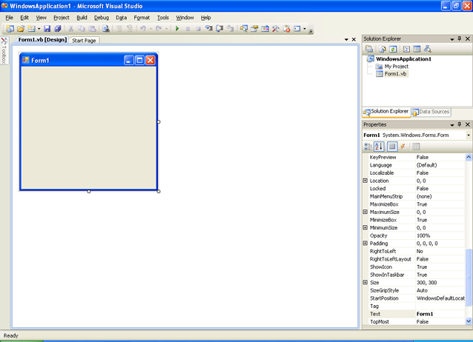
Visual Basic

Slide 45
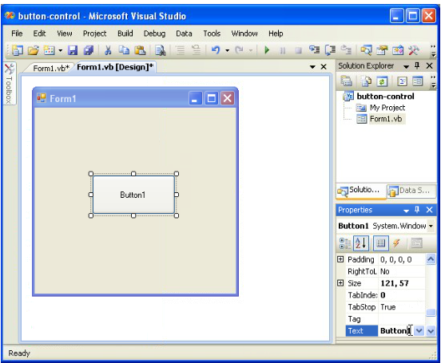
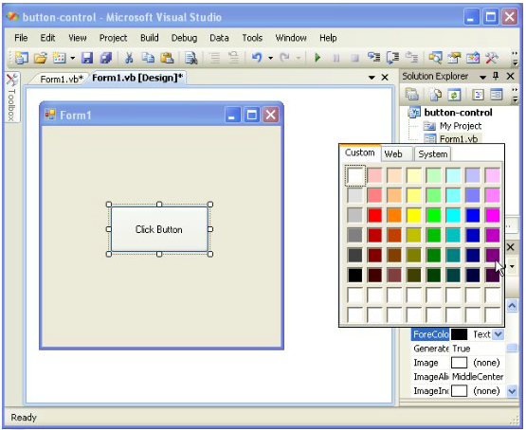
Add button, Edit properties

Slide 46
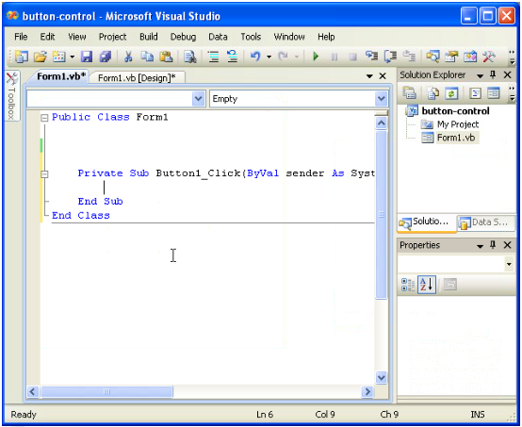
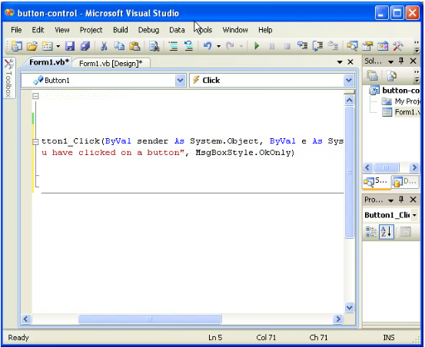
Add callback procedure

Slide 47
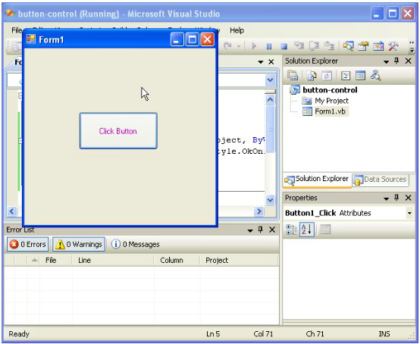
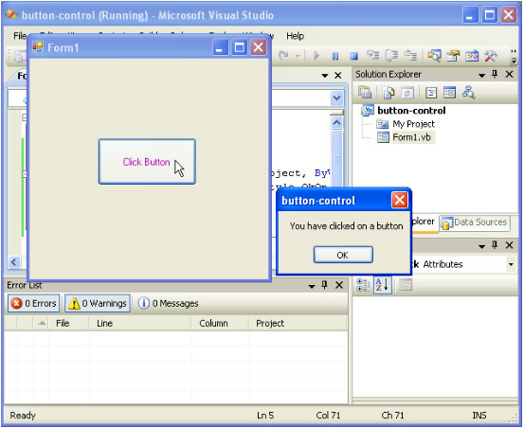
Run

Slide 48
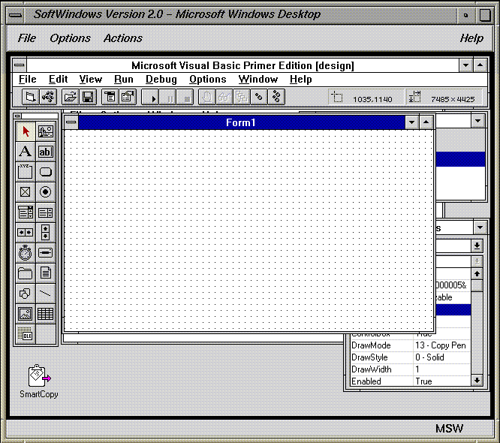

Slide 49
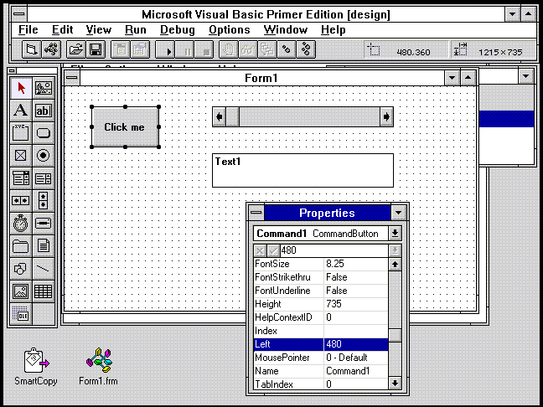

Slide 50
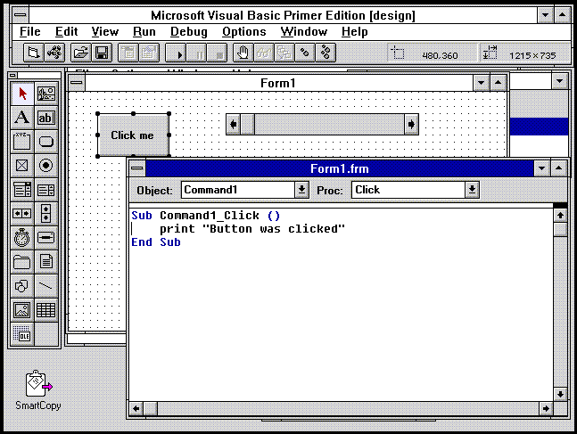

Slide 51
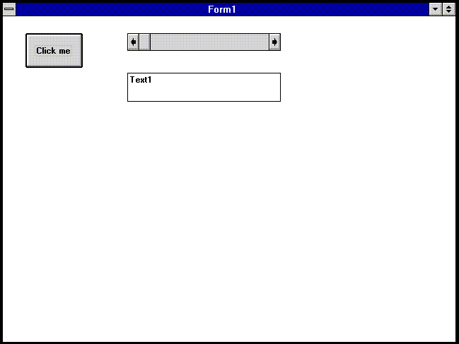

Slide 52
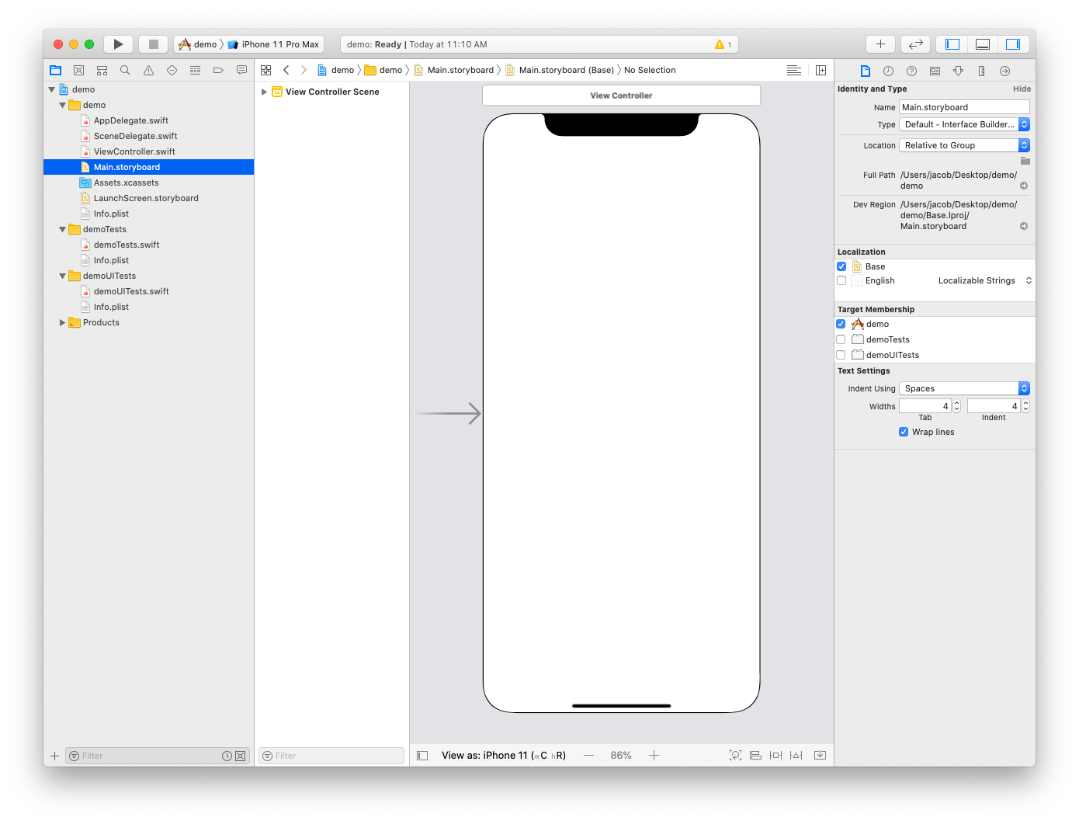
Xcode

Slide 53
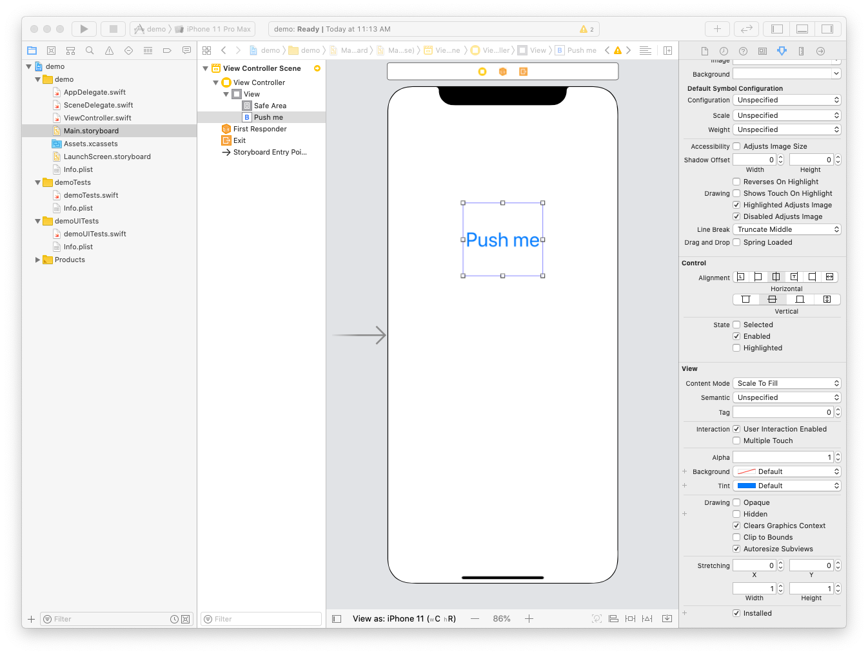
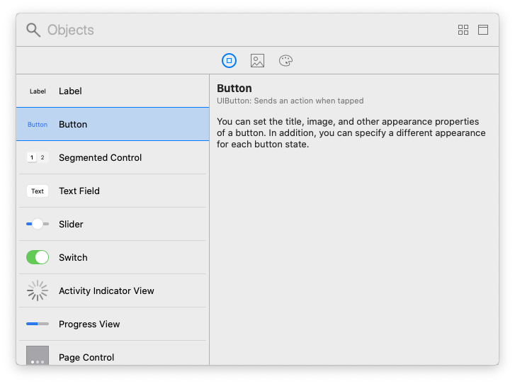
Add button

Slide 54
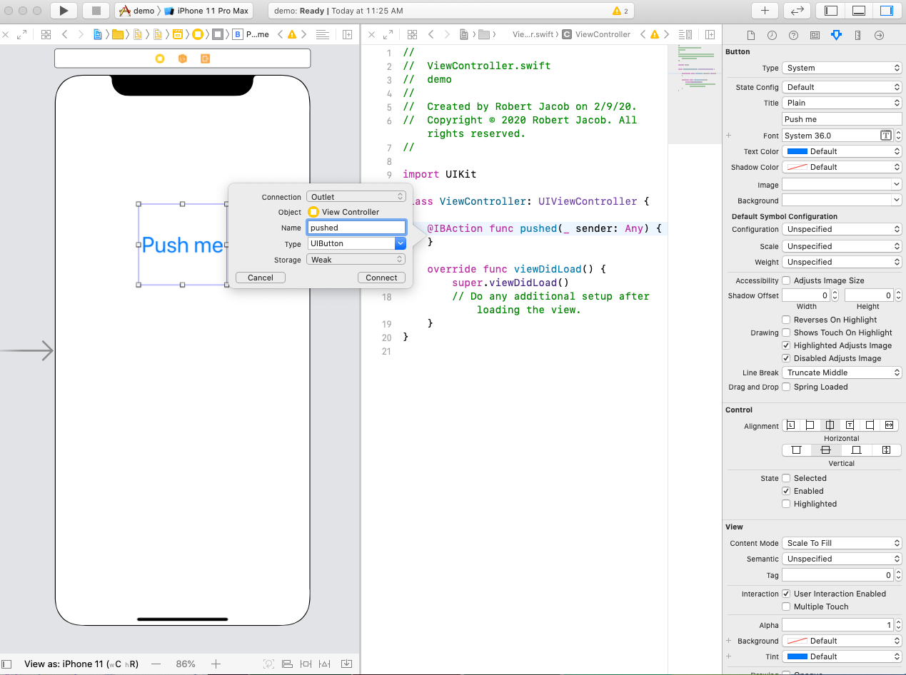
Add callback procedure

Slide 55
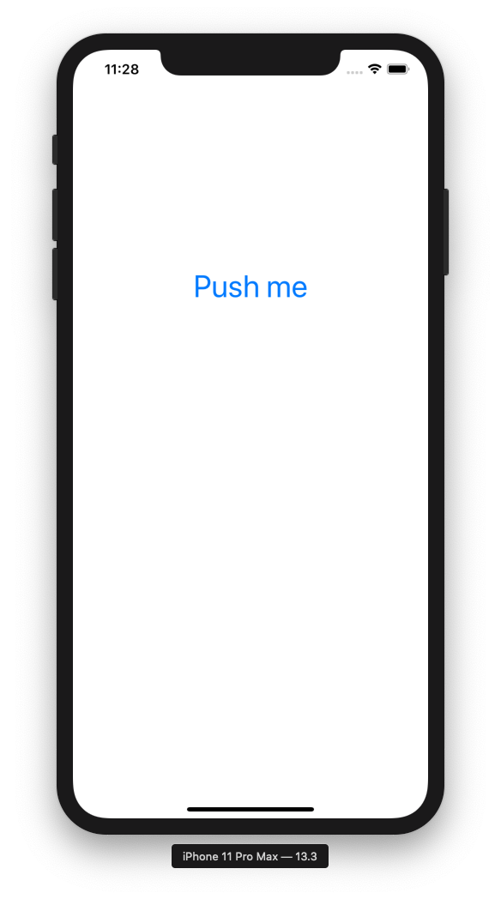
Run on simulator

